Slide 1

PTOLEMY’S THEOREM:
A well-known result that is not that well-known.
Pat Touhey
Misericordia University
Dallas, PA 18612
ptouhey@misericordia.edu

Slide 2
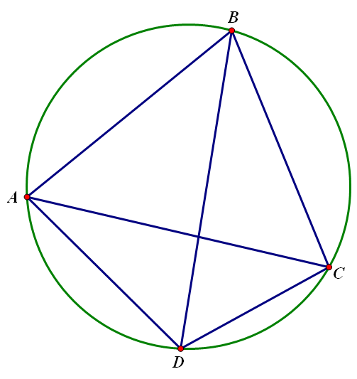
Ptolemy’s
Theorem
The product of the diagonals equals the sum of the products of the two pairs of opposite sides.

Slide 3
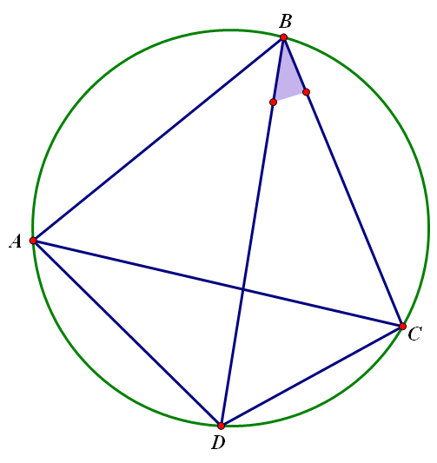
(Proof)
First,
consider

Slide 4
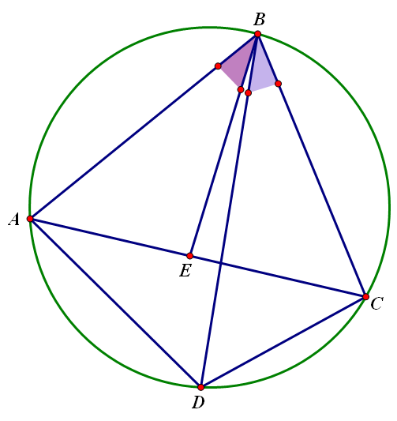
then
Construct
equal to
(Elements I - 23)

Slide 5
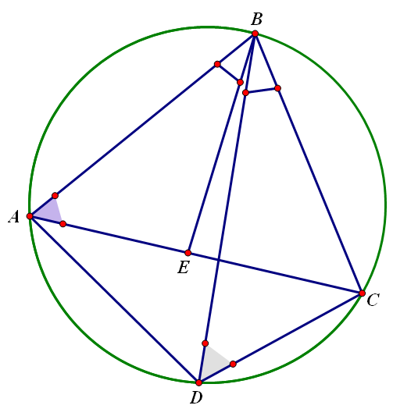
But we also have

Slide 6
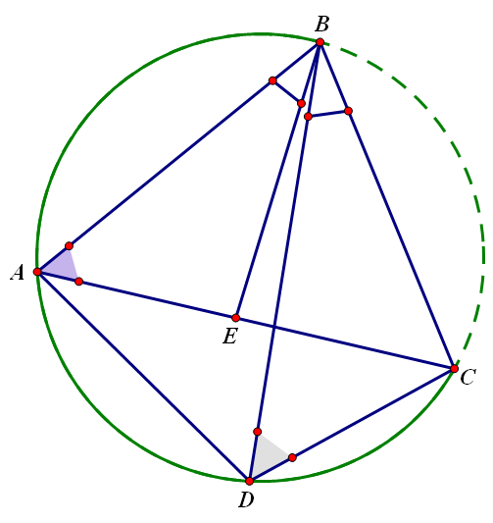
But we also have
Since they are inscribed angles intercepting the same arc.
(Elements III – 21)

Slide 7
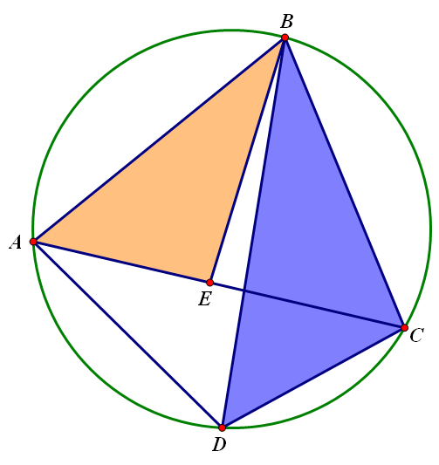
Thus we have
similar triangles.

Slide 8
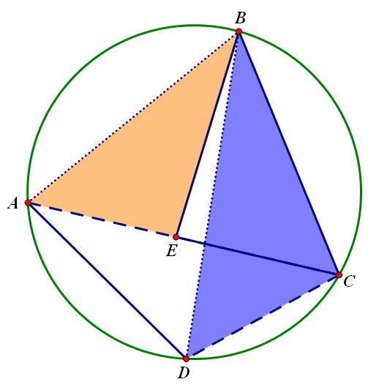
Thus we have
similar triangles.
And by corresponding parts,

Slide 9
Thus we have
similar triangles.
And by corresponding parts,
So (1)

Slide 10
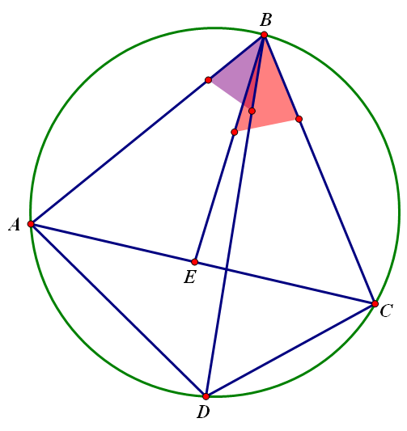
Now note since
=

Slide 11
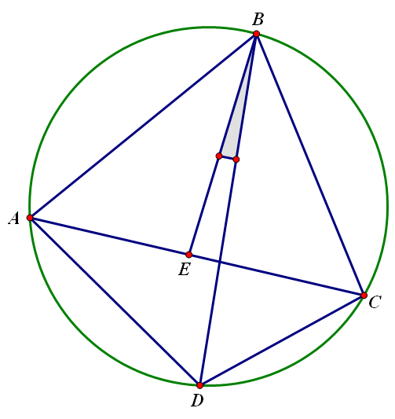
Now note since
=
adding
to both

Slide 12
yields

Slide 13
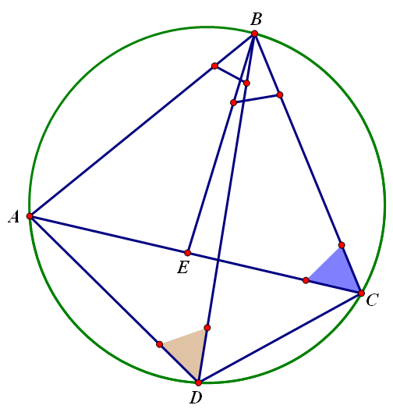
But we also have

Slide 14
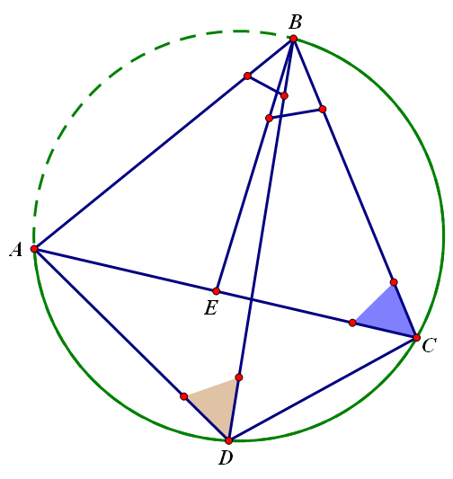
But we also have
Again,
since they are inscribed angles intercepting the same arc.

Slide 15
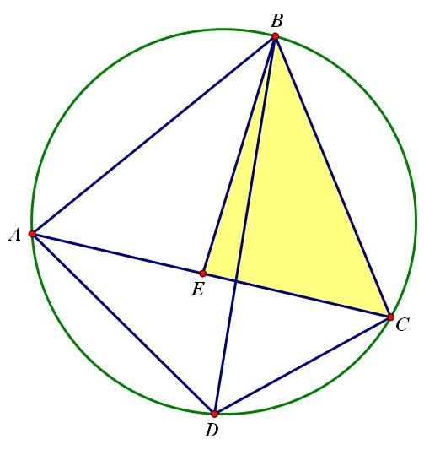
And so we have similar, overlapping triangles,

Slide 16
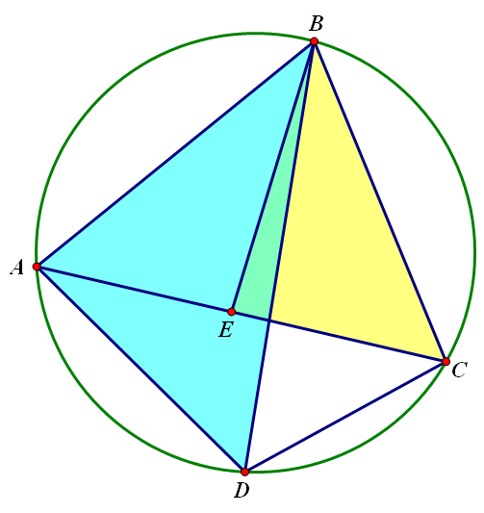
And we have similar, overlapping triangles,

Slide 17
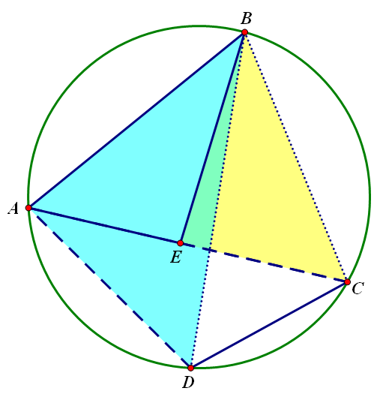
And by corresponding parts we have
So (2)

Slide 18
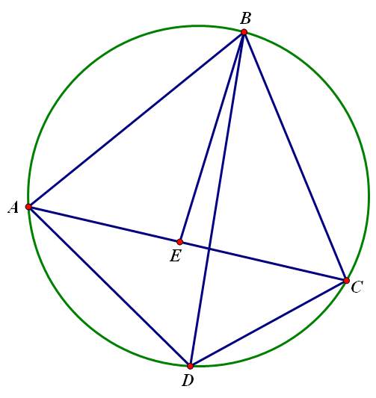
Now consider our two equations,
(1)
and
(2)

Slide 19
plus
yields

Slide 20
plus
yields

Slide 21
plus
yields

Slide 22
Ptolemy’s
Theorem
The product of the diagonals equals the sum of the products of the two pairs of opposite sides.

Slide 23
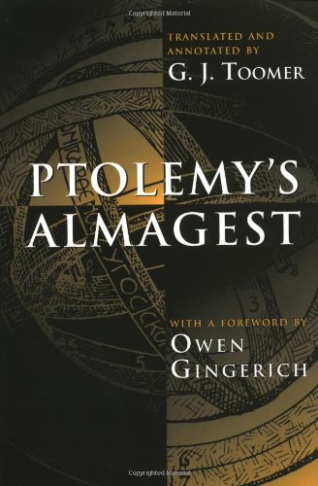
Ptolemy’s Almagest
translated by G. J. Toomer , Princeton (1998)

Slide 24
Ptolemy’s - “Almagest” - c.150 AD
“…by the early fourth century … the Almagest had become the standard textbook on astronomy which it was to remain for more than a thousand years.
It was dominant to an extent and for a length of time which is unsurpassed by any scientific work except Euclid’s Elements.”
- G.J. Toomer

Slide 25
Ptolemy’s “Almagest”
* Early mathematical Astronomy
* Based on Spherical Trigonometry
* Table of Chords
* Plane Trigonometry

Slide 26
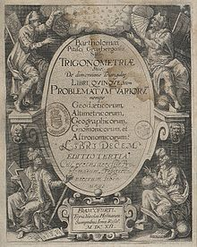
Trigonometriae – 1595 by Bartholomew Pitiscus

Slide 27
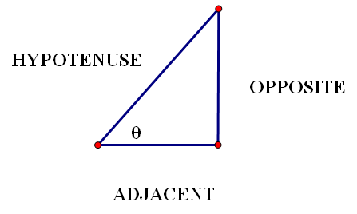
Trigonometry
Right Triangles
SOHCAHTOA

Slide 28
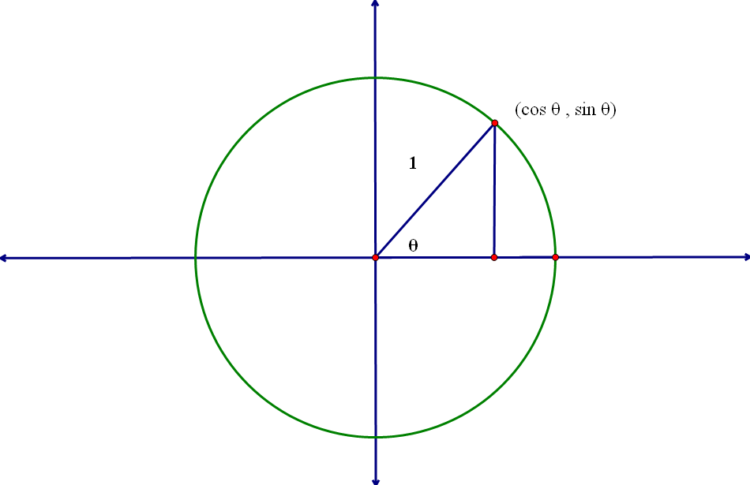
Radius = 1 Center (0,0)
Geometry
of the
Unit Circle

Slide 29
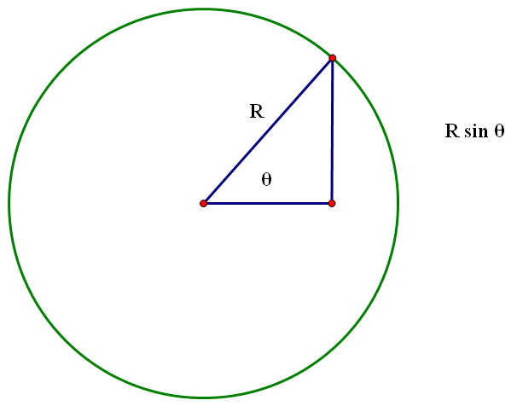
Geometry of the Circle
A circle of radius R
and an angle

Slide 30
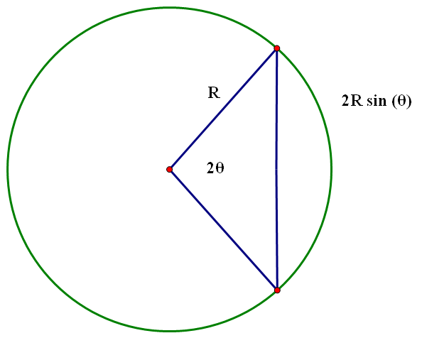
Duplicate the configuration to form an angle
and its associated
chord

Slide 31
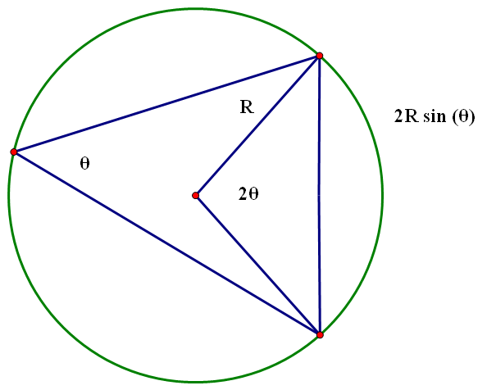
And any inscribed angle cutting off that chord measures

Slide 32
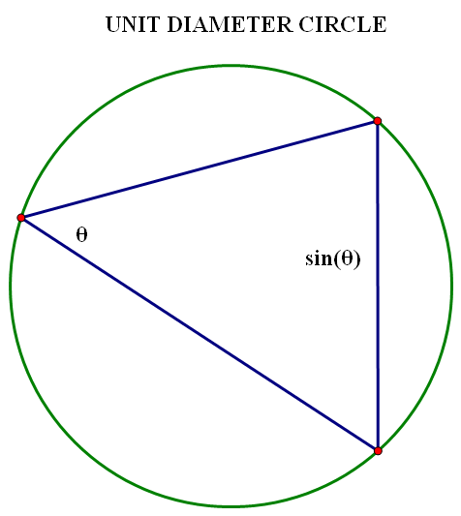
Now let R = ½
So that
the diameter is a unit.
And we see that the chord subtended by an inscribed angle
is simply

Slide 33
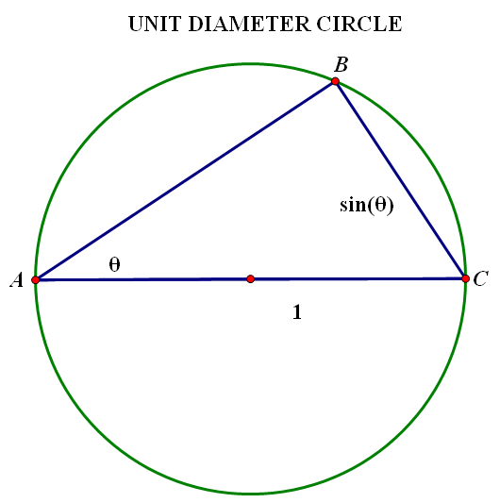
Using the diameter as one side of the inscribed angle we have a triangle.

Slide 34
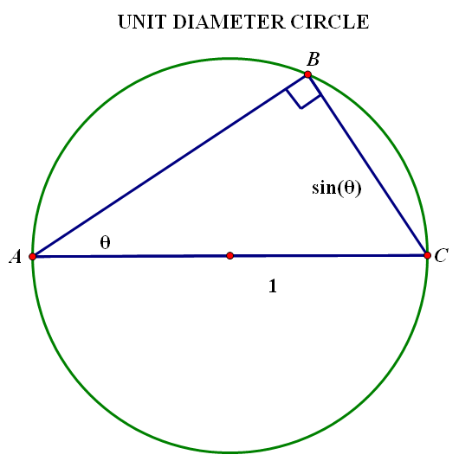
Using the diameter as one side of the inscribed angle we have a triangle.
A right triangle,
by Thales.

Slide 35
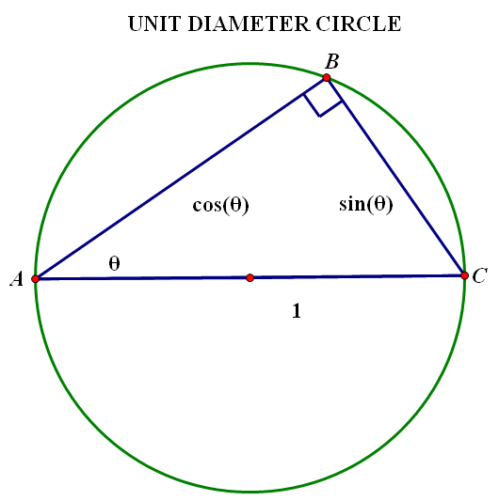
And by
SOHCAHTOA
we have the
Pythagorean Identity

Slide 36
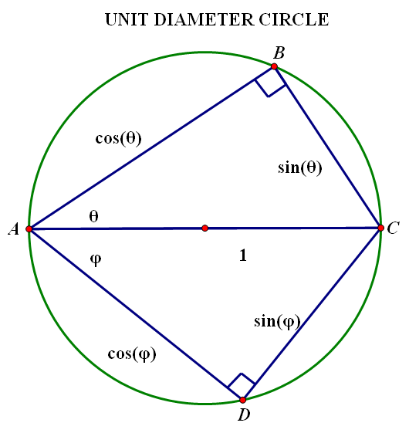
Using another inscribed angle perform similar constructions on the other side of the diameter AC.
The two triangles form a quadrilateral.

Slide 37
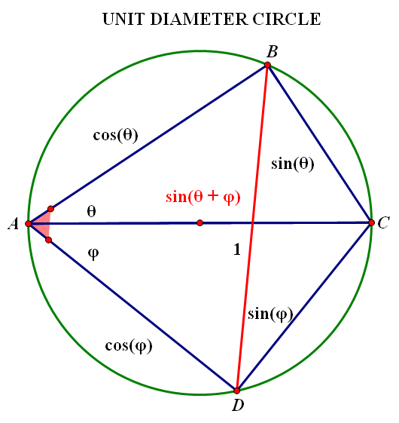
The diameter is one diagonal.
Construct the other and use Ptolemy.

Slide 38
The diameter is one diagonal.
Construct the other and use Ptolemy.
To get the addition formula for sine.

Slide 39
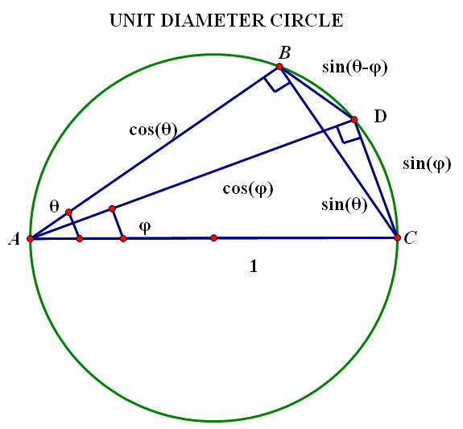
Ptolemy’s
Almagest
The first corollary of
Ptolemy’s Theorem.

Slide 40
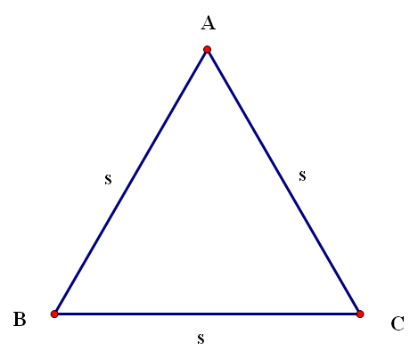
Consider an equilateral triangle

Slide 41
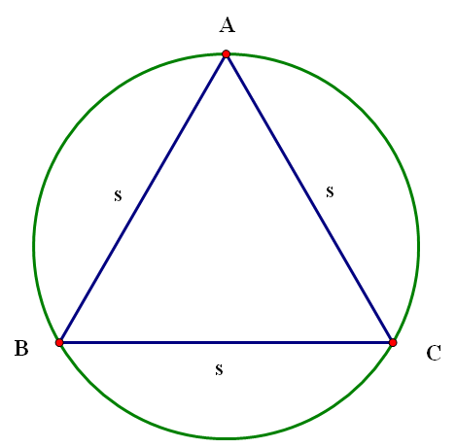
Construct the circumcircle

Slide 42
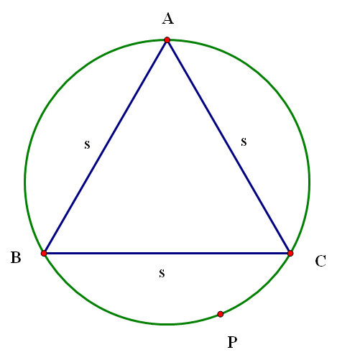
Pick any point on the circumcircle

Slide 43
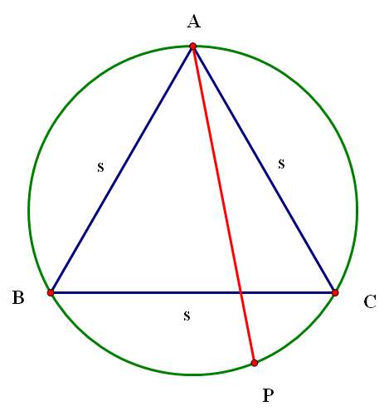
Draw the segment from to the farthest vertex,

Slide 44
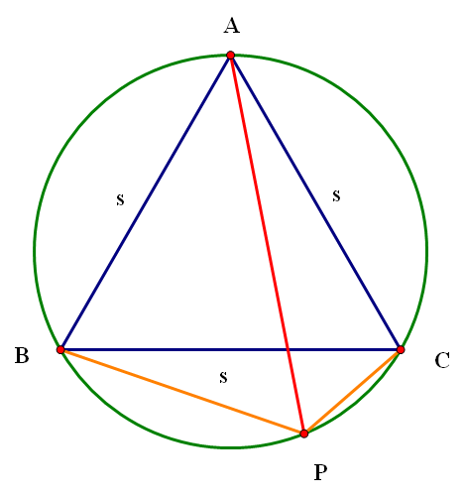
Draw the segment from to the farthest vertex
It equals the sum of the segments to the other vertices

Slide 45
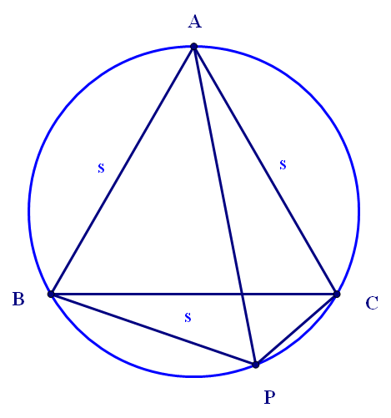
(Proof)
Consider the quadrilateral ACPB and use Ptolemy’s.

Slide 46
(Proof)
Consider the quadrilateral ACPB and use Ptolemy’s.

Slide 47
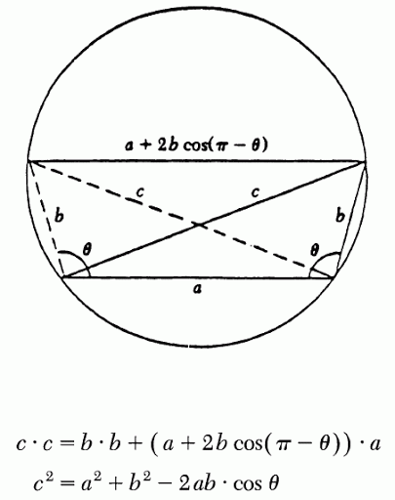
Law of cosines via Ptolemy's theorem
Kung S.H.
(1992).
Proof without Words:
The Law of Cosines
via Ptolemy's Theorem,
Mathematics Magazine,
65 (2) 103.

Slide 48
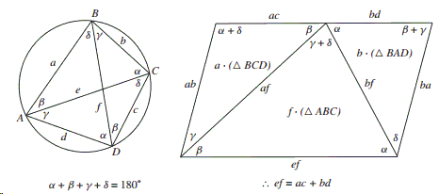
Derrick W. & Hirstein J. (2012).
Proof Without Words: Ptolemy’s Theorem,
The College Mathematics Journal, 43 (5) 386-386.
http://docmadhattan.fieldofscience.com/2012/11/proofs-without-words-ptolemys-theorem.html

Slide 49
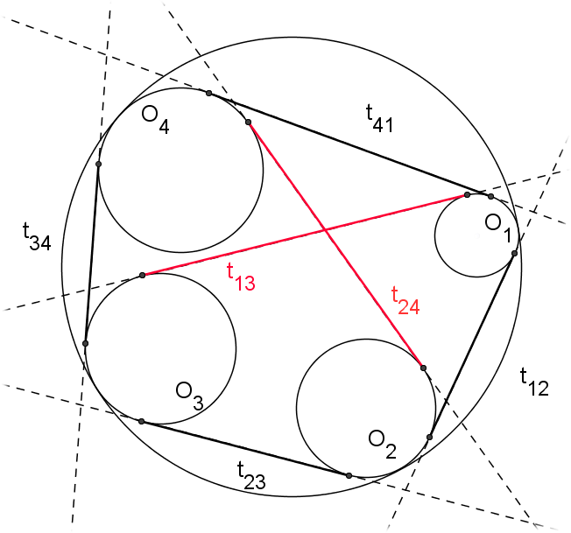
Casey’s Theorem
Casey, J. (1866), Math. Proc. R. Ir. Acad. 9: 396.

Slide 50
References:
Ptolemy’s Almagest:
translated by G. J. Toomer , Princeton (1998)
Euclid’s Elements
translated by T. L. Heath, Green Lion (2002)
Trigonometric Delights
by Eli Maor, Princeton (1998)
The Mathematics of the Heavens and the Earth
by Glen Van Brummelen, Princeton (2009)

