Slide 1
The Existence of the Nine-Point Circle for a Given Triangle
Stephen Andrilli
Department of Mathematics and Computer Science
La Salle University, Philadelphia, PA

Slide 2
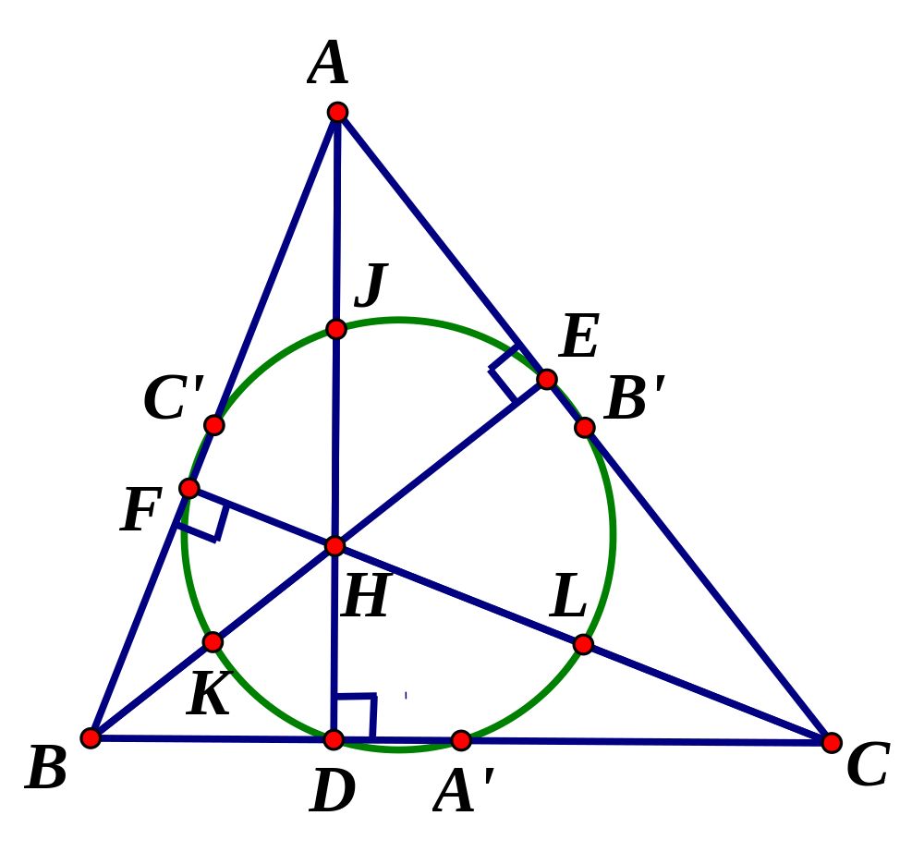
Preliminaries
  First, a review of some familiar geometric results that are useful for the proof of the Nine-Point Circle Theorem.
  Short proofs will be given for some results.
  The Nine-Point Circle proof then follows quickly from these.

Slide 3
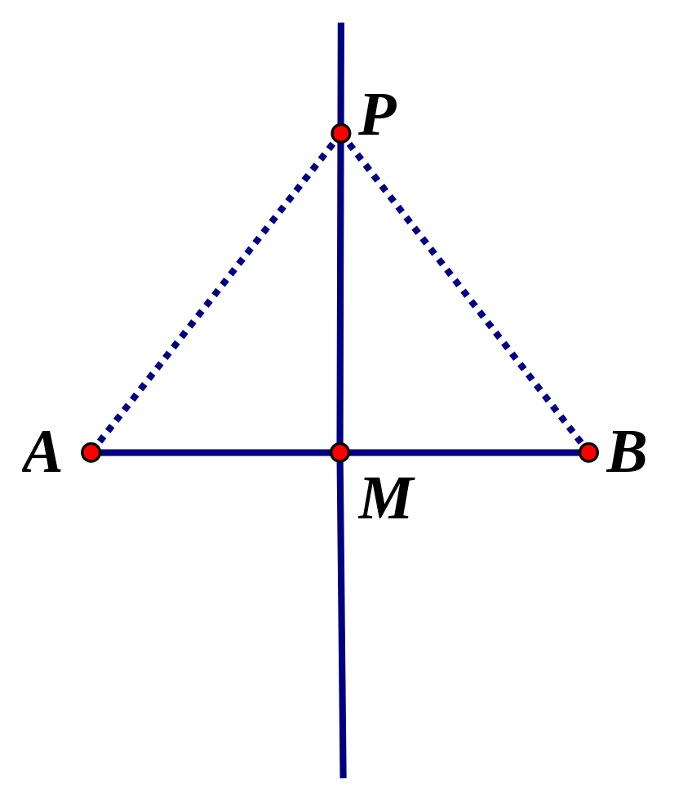
Preliminaries: Point Equidistant From Two Other Points
If a point P is equidistant from two other points A and B then P is on the perpendicular bisector of AB.
(If PA = PB, and M is the midpoint of AB, then PM ⊥ AB.)

Slide 4
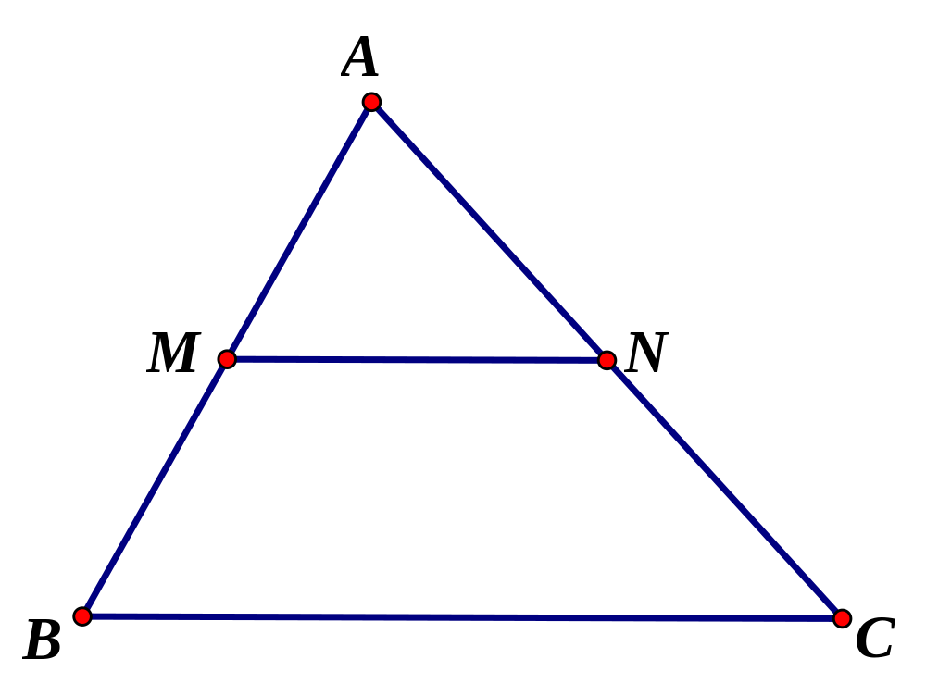
Preliminaries: Midpoint Theorem
In any triangle, the line segment connecting the midpoints of any two sides is parallel to the remaining side, and half its length.
If M is the midpoint of AB, and N is the midpoint of AC, then MN  BC, and MN = ½ BC.

Slide 5
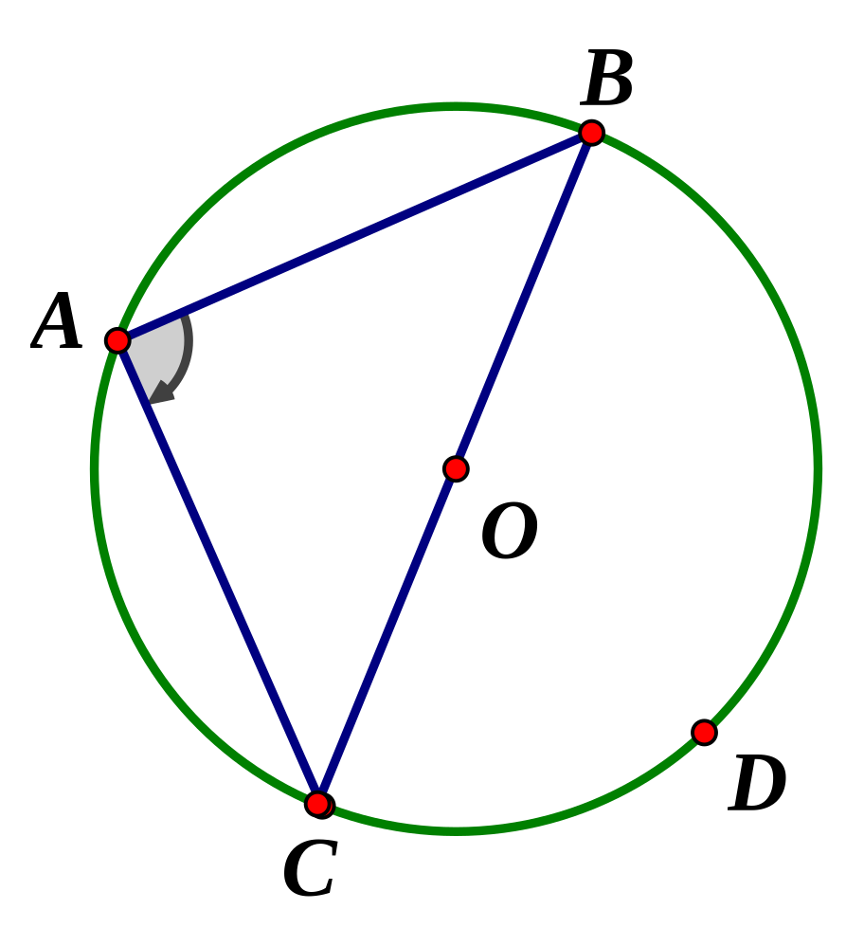
Preliminaries: Inscribed Angles, Right Triangles
The measure of an angle inscribed in a circle is half the measure of the subtended arc.
m(∠A) = ½ m(arc BDC)
Any right triangle can be inscribed in a circle whose diameter is the hypotenuse of the right triangle.

Slide 6
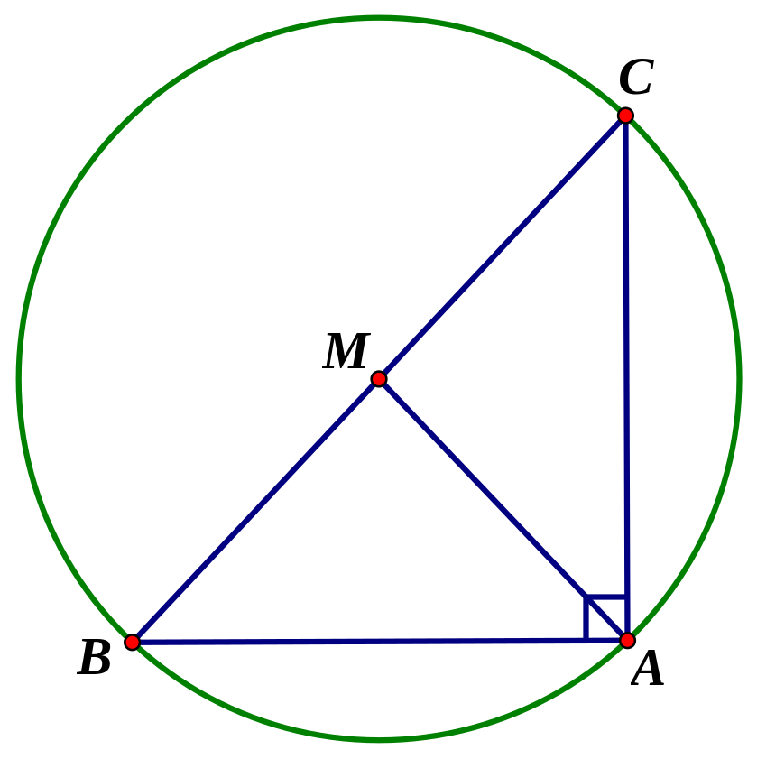
Preliminaries: Hypotenuse Midpoint Theorem
In any right triangle, the line segment connecting the right angle to the midpoint of the hypotenuse is half the length of the hypotenuse.
Proof: Let ABC be a right  with ∠A = 90°. Then  ABC is inscribed in a circle with diameter BC. The center of this circle is the midpoint M of BC.  AM = BM = CM.

Slide 7
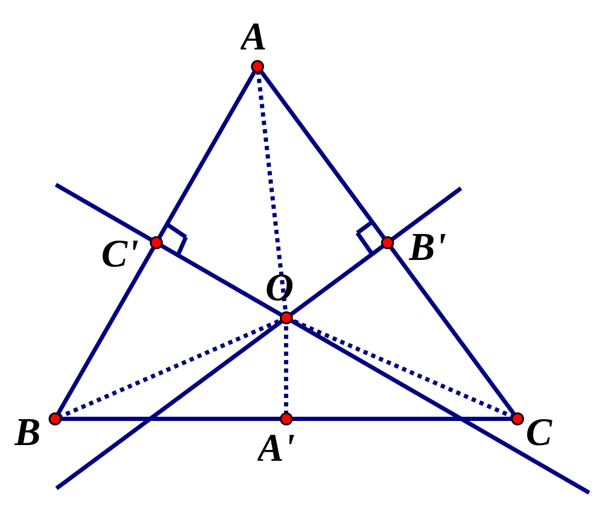
Preliminaries: Circumcenter
For any ABC, the perpendicular bisectors of the three sides are concurrent, at a point called the circumcenter (labeled as O).
Proof (beg.): Let C′, B′, A′ be the
midpoints of the sides
of ABC as shown. Let the
perpendicular bisectors of
AB and AC meet at O.
We must show OA′ ⊥ BC.

Slide 8
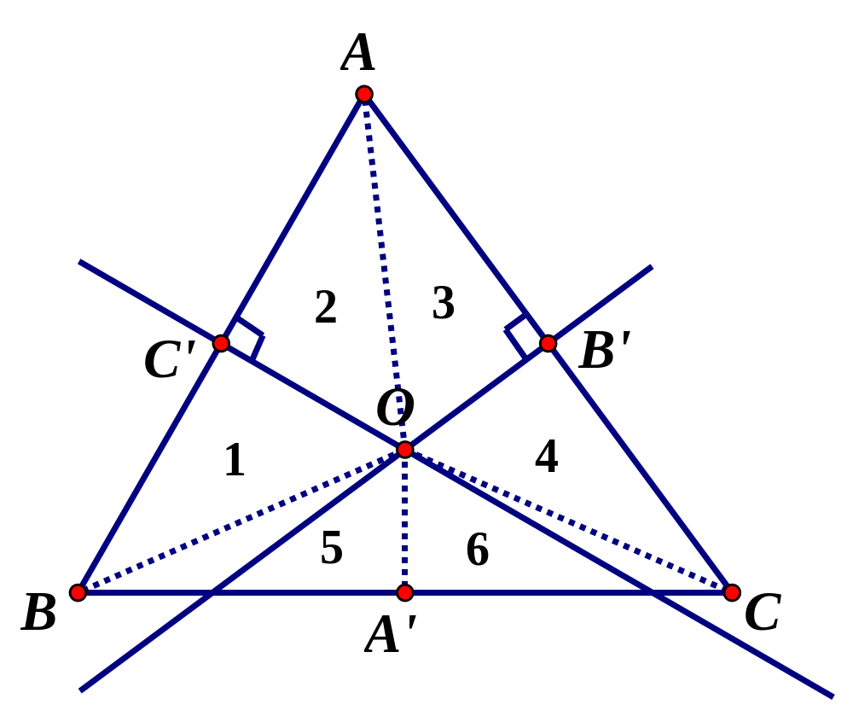
Preliminaries: Circumcenter
[For any triangle ABC, the perpendicular bisectors of the sides are concurrent.]
Proof (concl.): 1  2
and 3  4 (by SAS).
 AO = BO, and AO = CO.
Hence, BO = CO.
Then, 5  6 (by SSS).
 ∠BA′O  ∠CA′O,
so these are 90° angles.
Hence, OA′ ⊥ BC.

Slide 9
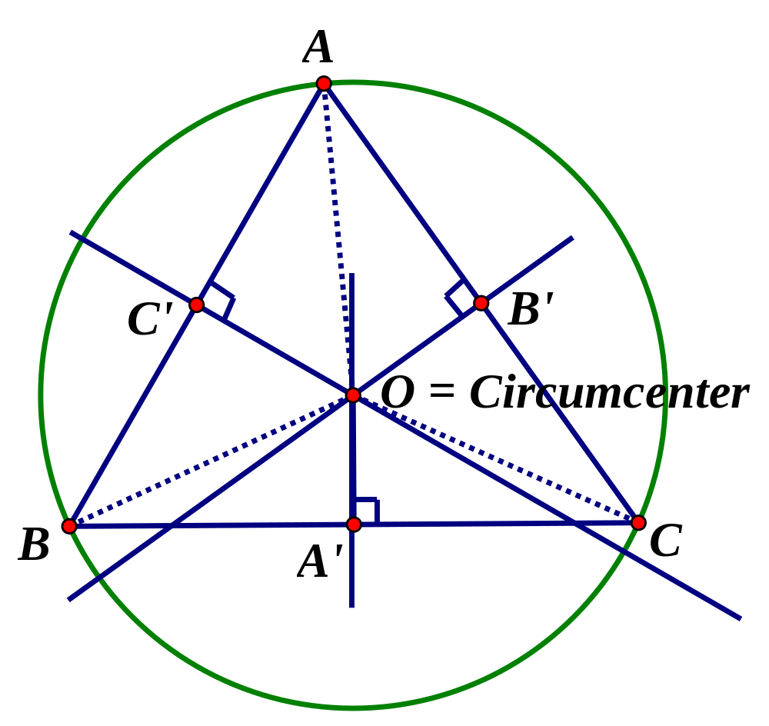
Preliminaries: Unique Circle Through 3 Noncollinear Points
If O is the circumcenter of ∆ABC, then AO = BO = CO.
Thus, any three noncollinear points A, B, C lie on a circle with center O.
But the circle through A, B, C is unique!
Proof: Let P be the center of a circle containing A, B, C. Then, P must be equidistant from A, B, C, and so P must be on all 3 perpendicular bisectors for ABC. But O is the intersection of these perpendicular bisectors.  P = O.

Slide 10
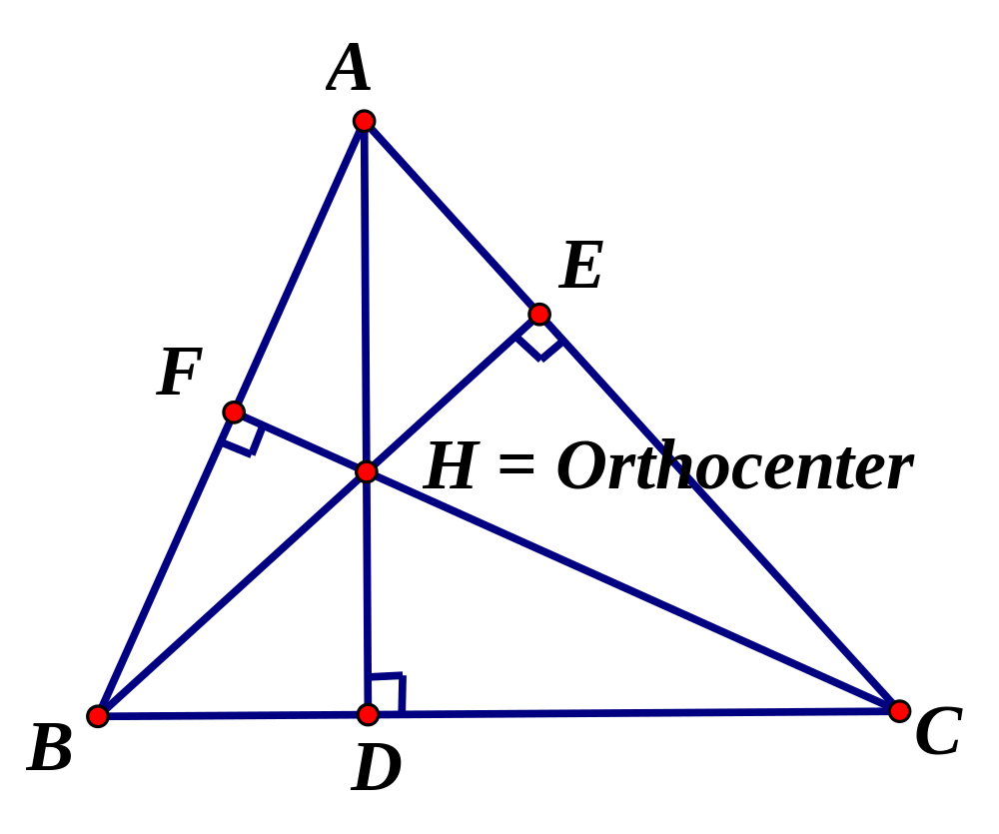
Preliminaries: Orthocenter
For any triangle, the three altitudes are concurrent, at the orthocenter (labeled as H).

Slide 11
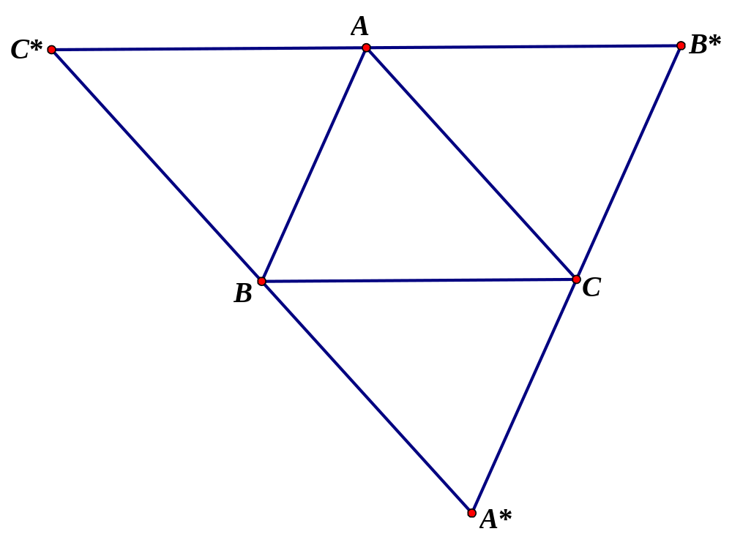
Preliminaries: Orthocenter (cont’d)
[The three altitudes are concurrent.]
Proof (beg.): Construct lines through A, B, C, each parallel to the opposite side, and let them intersect in A*, B*, C* as shown.
From the parallelograms formed, we have C*A = BC = AB*, so A is the midpoint of C*B*.
Similarly, B is the midpoint of C*A*, and C is the midpoint of B*A*.
Thus, A, B, C are the midpoints of the sides of C*B*A*.

Slide 12
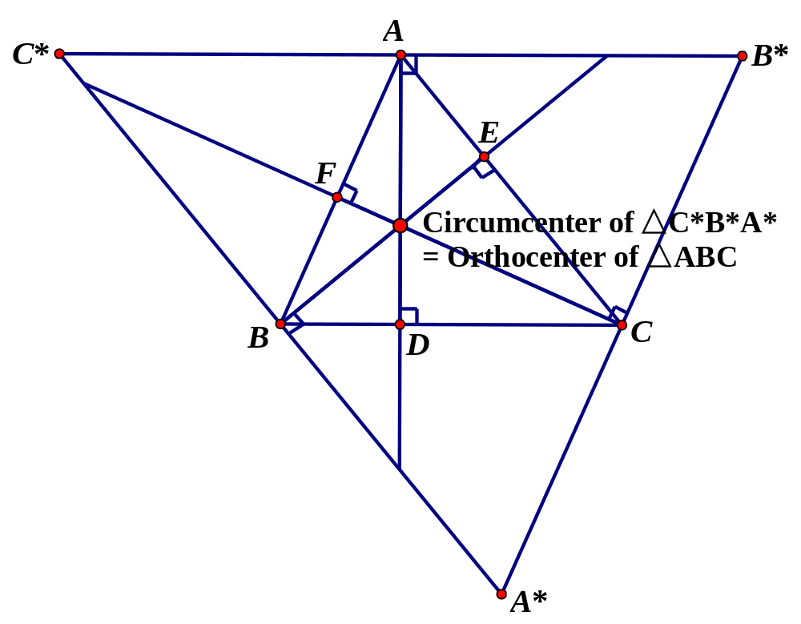
Preliminaries: Orthocenter (cont’d)
Proof (concl.): The circumcenter of C*B*A* exists (intersection of its three perpendicular bisectors). But these perpendicular bisectors overlap the altitudes of ABC, so they also form the orthocenter of ABC.

Slide 13
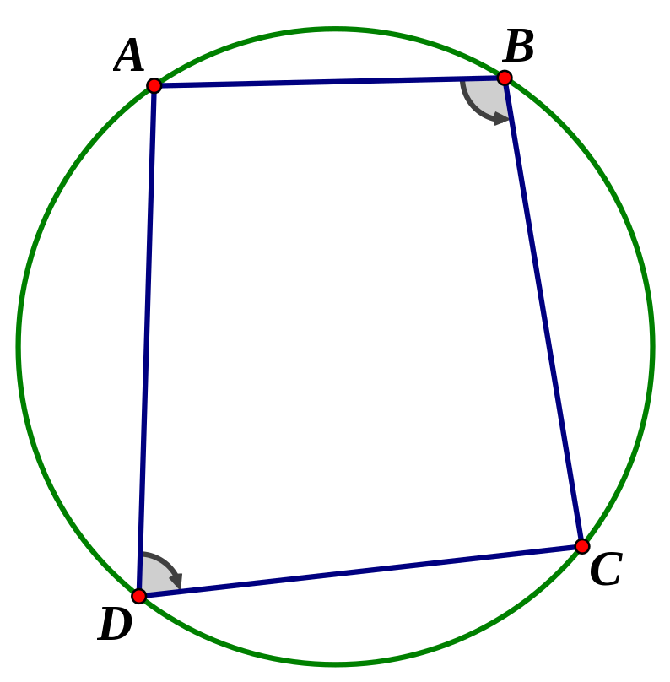
Preliminaries: Cyclic Quadrilaterals
A quadrilateral is inscribed in a circle (that is, the quadrilateral is cyclic) if and only if its opposite angles are supplementary.
Proof: Part 1: If ABCD is inscribed in a circle, then ∠B = ½ m(arc ADC), and ∠D = ½ m(arc ABC). The sum of these arcs = 360°, so ∠B + ∠D = 180°.

Slide 14
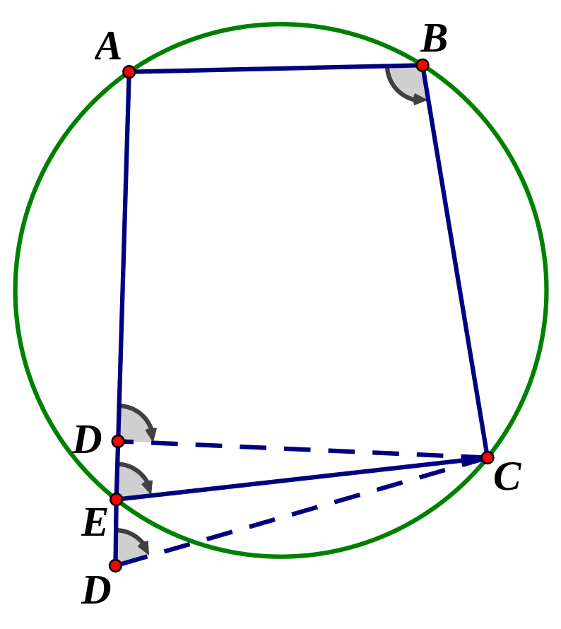
Preliminaries: Cyclic Quadrilaterals
[A quadrilateral is inscribed in a circle (that is, the quadrilateral is cyclic) if and only if its opposite angles are supplementary.]
Proof: Part 2: Let ∠B + ∠D = 180° in quadrilateral ABCD. If D is either inside or outside the circle through A, B, C, then let E be the point where (extended) AD meets the circle. Now, ∠B + ∠E = 180° by Part 1. But then transversal AD cuts off equal angles at DC and EC, a contradiction. Thus, D is on the circle through A, B, C.

Slide 15
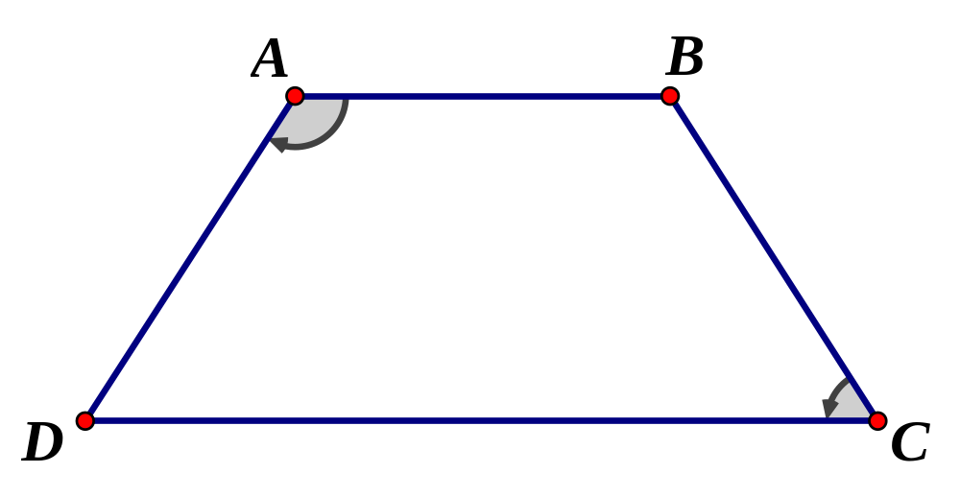
Preliminaries: Isosceles Trapezoids
In an isosceles trapezoid, opposite angles are supplementary.
Proof: By symmetry, ∠A = ∠B, and ∠C = ∠D.  2∠A + 2∠C = 360°, so ∠A + ∠C = 180°.
Therefore, an isosceles trapezoid is a cyclic quadrilateral and can be inscribed in a circle!

Slide 16
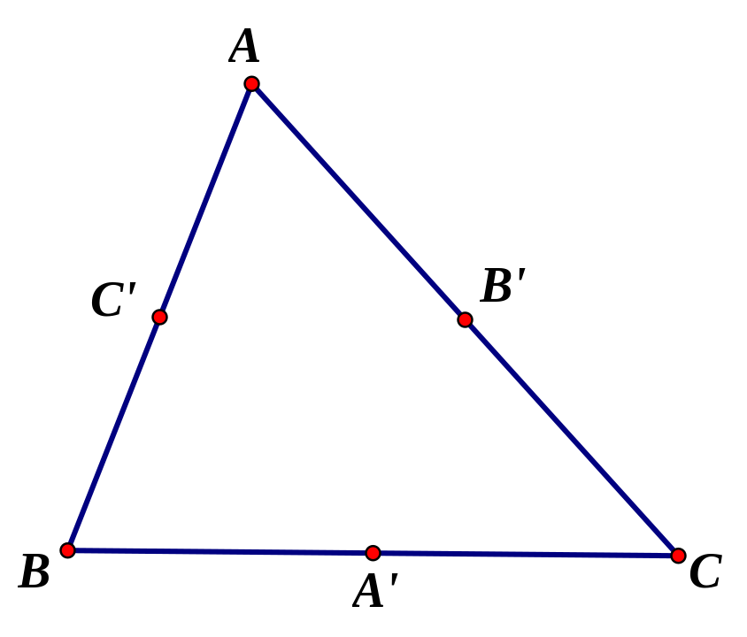
Notation: Midpoints
For ABC,
let A′ be the midpoint of side BC,
let B′ be the midpoint of side AC, and
let C′ be the midpoint of side AB.

Slide 17
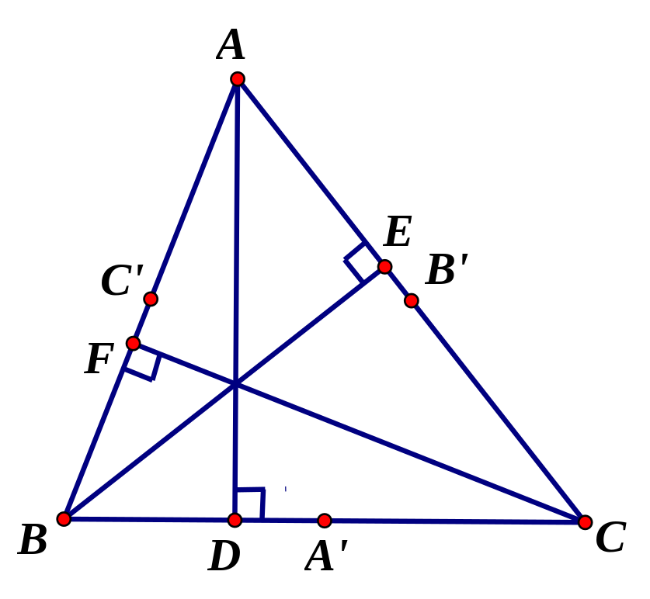
Notation: Feet of the Altitudes
For ABC,
let D be the foot of the altitude from A to BC,
let E be the foot of the altitude from B to AC, and
let F be the foot of the altitude from C to AB.

Slide 18
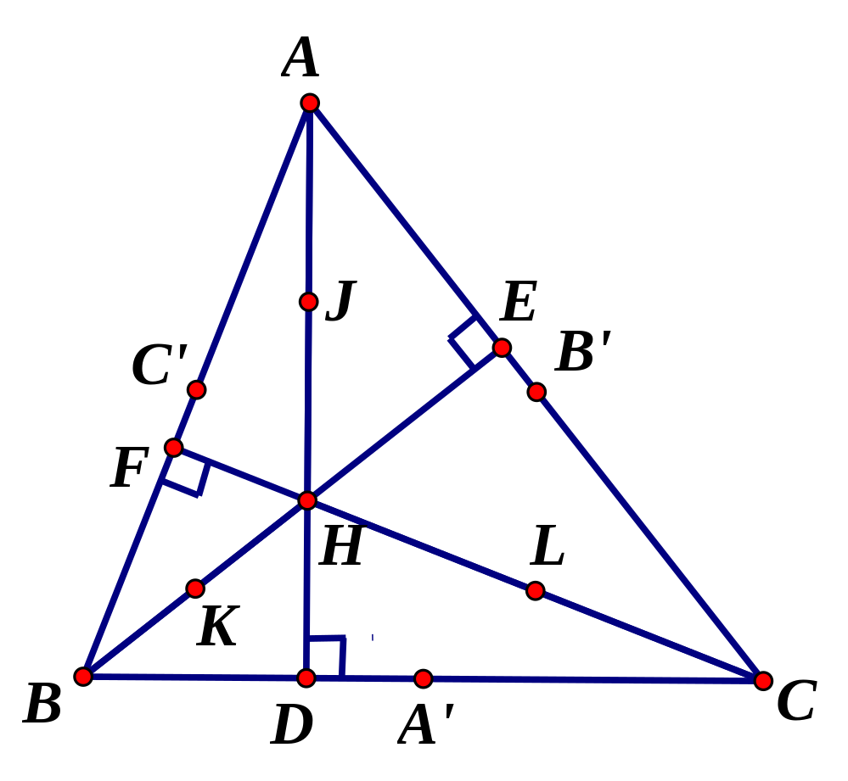
Notation: Midpoints from Orthocenter to Vertices
For ABC,
let H be the orthocenter (intersection of the altitudes),
let J be the midpoint of AH,
let K be the midpoint of BH, and
let L be the midpoint of CH.

Slide 19
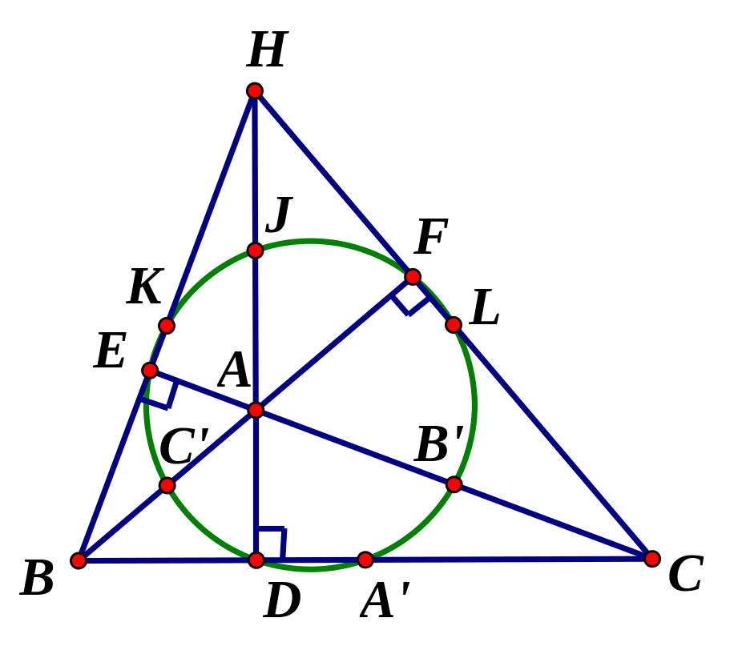
The Nine-Point Circle of ABC
Theorem: For any triangle ABC, the following points lie on a unique common circle (the “Nine-Point Circle”):
  The midpoints A′, B′, C′ of the sides
  The feet of the altitudes D, E, F
  The midpoints J, K, L from the orthocenter to the vertices
  Acute ∆ Obtuse ∆

Slide 20
Proof of the Nine-Point Circle Theorem (beginning)
Proof:
Consider the unique circle through the midpoints A′, B′, C′.
We must show that D, E, F, J, K, L are also on this circle.
It is enough to show that D and J are on this circle, because a similar argument can be used for the remaining points.

Slide 21
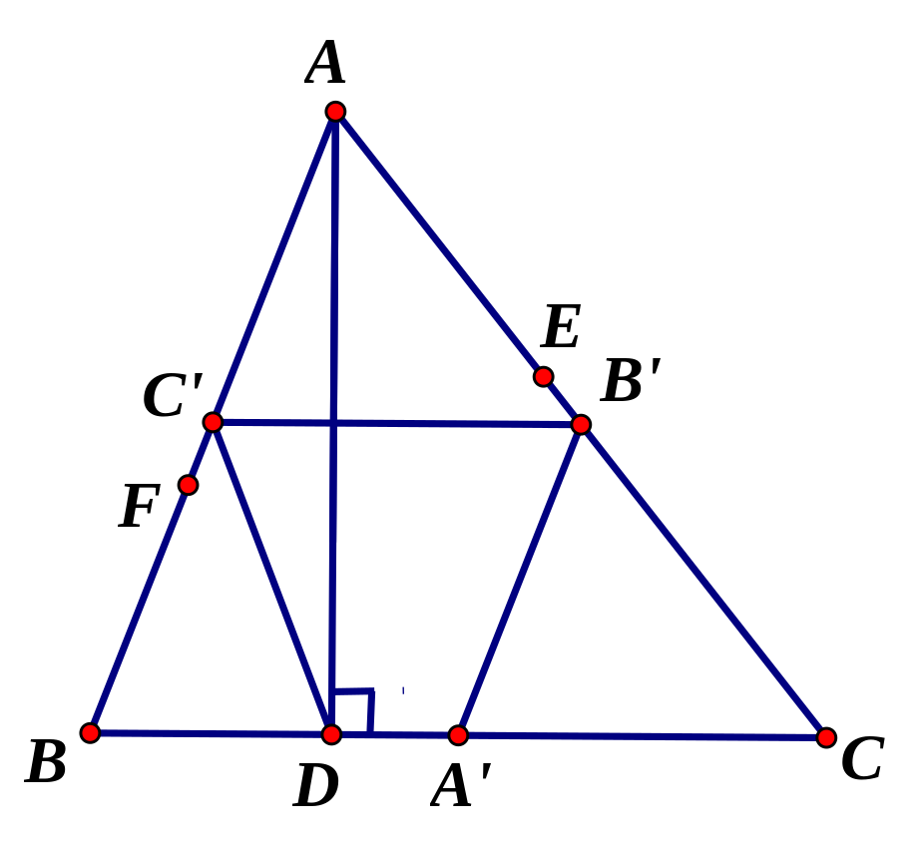
Proof that D is on the Circle Through A′, B′, C′ (beginning)
If D = A′, we are done.
Otherwise, consider quadrilateral DC′B′A′.
B′C′  DA′ by the Midpoint Theorem,
so DC′B′A′ is a trapezoid.
A′B′ = ½ (AB) by the Midpoint Theorem
DC′ = AC′ = ½ (AB) by the
Hypotenuse Midpoint Theorem
 A′B′ = DC′, and so
DC′B′A′ is an isosceles
trapezoid!

Slide 22
Proof that D is on the Circle Through A′, B′, C′ (conclusion)
Since DC′B′A′ is an isosceles trapezoid, points D, C′, B′, A′ lie on a common circle.
But since the circle through any
three noncollinear points
is unique, D must lie on
the circle through
A′, B′, C′. Done!

Slide 23
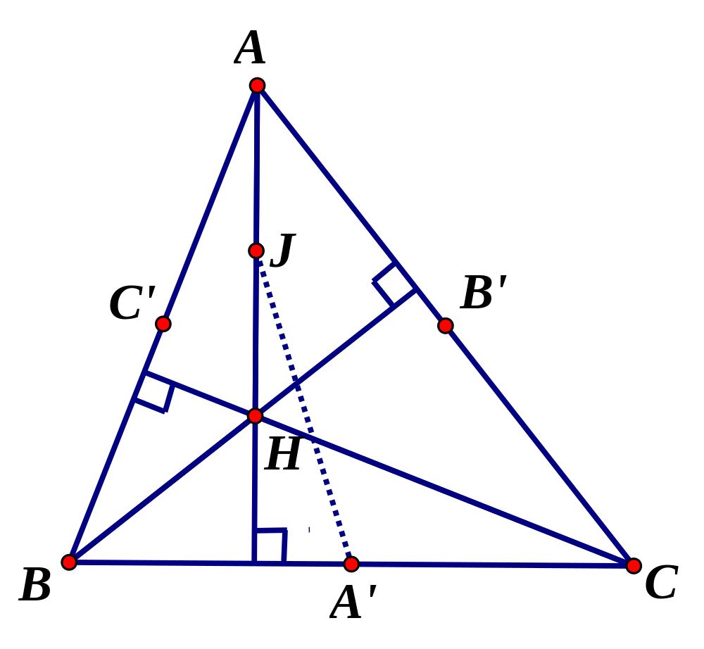
Proof that J is on the Circle Through A′, B′, C′ (beginning)
Finally, if we show the circle with
diameter JA′ contains points B′ and C′,
then all four points
J, A′, B′, C′ lie on a
common circle.
It is enough to prove ∠JB′A′ = 90° and ∠JC′A′ = 90°.

Slide 24
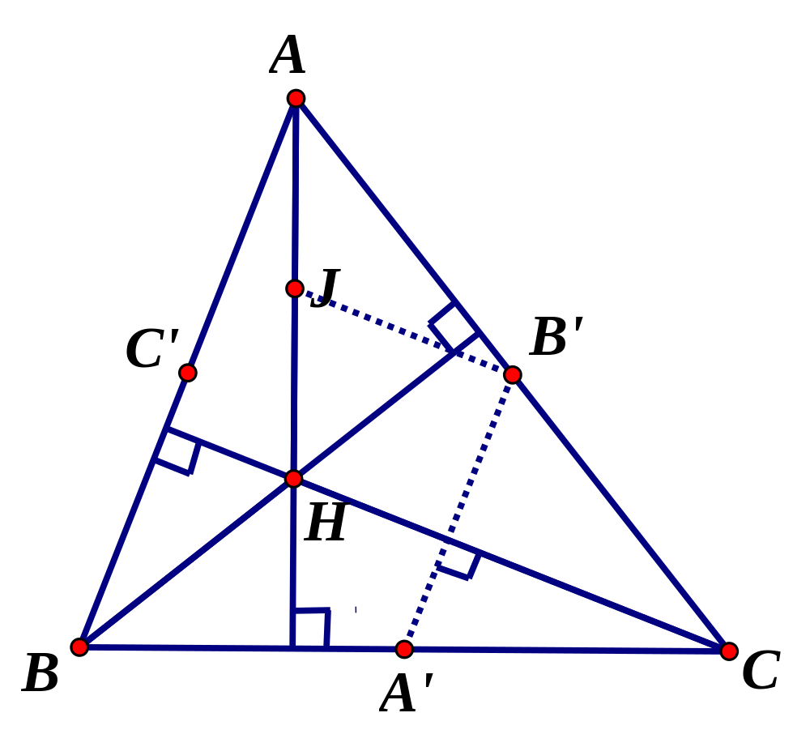
Proof that J is on the Circle Through A′, B′, C′ (continued)
JB′  HC by the Midpoint Theorem.
B′A′  AB by the Midpoint Theorem.
But HC ⊥ AB since H is the
orthocenter of ABC.
Therefore, JB′ ⊥ B′A′.
Thus, ∠JB′A′ = 90°,
so B′ is on the circle
with diameter JA′.

Slide 25
The Proof is Complete!
A similar proof holds for C′. Thus, J is on the circle through A′, B′, C′.
Along with D and J, similar proofs show that E and F, and K and L are on this same circle.
Thus, all nine of these points lie on a common circle, the “Nine-Point Circle.”

Slide 26
Lab for Constructing the Nine-Point Circle using The Geometer’s Sketchpad
It is straightforward to create a lab using The Geometer’s Sketchpad in which students build a triangle and then construct its Nine-Point Circle.
Students can then easily verify that the Nine-Point Circle remains on all nine points when the vertices of the triangle are moved about randomly.

Slide 27

Contact Information
For a copy of the Nine-Point Circle Lab using Geometer’s Sketchpad, send an e-mail to: andrilli@lasalle.edu
Questions?

Slide 28
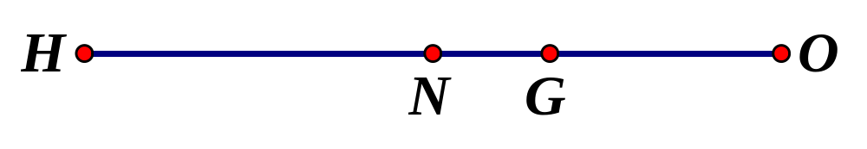
Other Interesting Theorems Related to the Nine-Point Circle
The radius of the nine-point circle is half the radius of the circumcircle. That is, if N is the center of the Nine-Point Circle for ABC, then NA′ = NB′ = NC′ is the radius of the nine-point circle, and NA′ = ½ OA.
The points H (orthocenter), N (center of the nine-point circle), G (centroid), and O (circumcenter) are collinear. The common line containing these points is called the Euler Line. It can be shown that N is the midpoint of HO, and that G is 2/3 of the distance from H to O.

Slide 29
Feuerbach’s Theorem and the Nine-Point Circle
There is a unique circle inside any ABC which is tangent to all three sides of the triangle. This circle is called the incircle of ABC.
There are three unique circles outside any ABC, each of which is externally tangent to one of the three sides of ABC and the other two extended sides of ABC. These three circles are called the excircles of ABC.
Feuerbach’s Theorem: The nine-point circle of any ABC is tangent to the incircle of ABC as well as all three excircles of ABC.

Slide 30
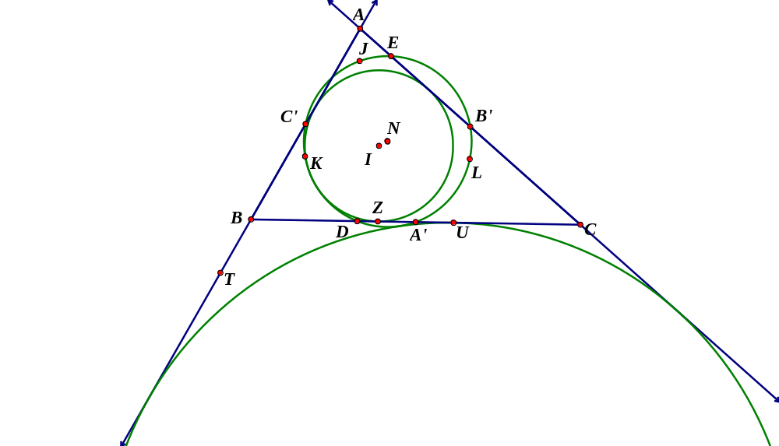
Feuerbach’s Theorem
Feuerbach’s Theorem: The nine-point circle of any ABC is tangent to the incircle of ABC as well as all three excircles of ABC.

Slide 31
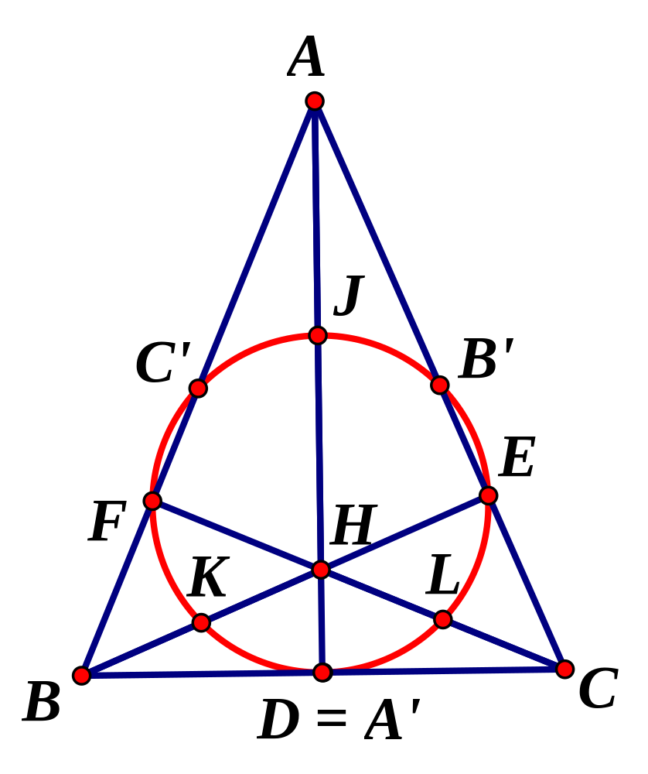
Not Always Nine!
In special cases, the 9 points A′, B′, C′, D, E, F, J, K, L are not necessarily distinct! For example, if ABC is isosceles with AB = AC, then the altitude AD is on the perpendicular bisector of BC, so D = A′.
If ABC is equilateral, then B′ = E and C′ = F as well.

Slide 32
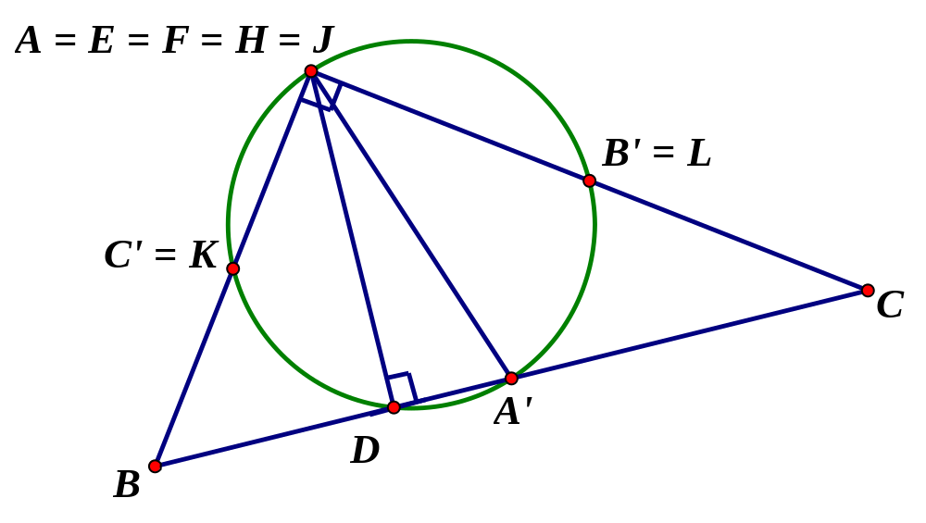
Not Always Nine!
Similarly, if A is a right angle, then A is actually the orthocenter of ∆ABC. In this case, A = E = F = H = J, and C′ = L, and B′ = K.

